Slide 1
Getting started with D3 : Creating Interactive Visualizations
Karina Assiter, Ph.D.
33rd Annual CCSC Rocky mountain Conference
October 18 – 19, 2024

Slide 2
Preliminary
Browser used in illustrations: CHROME.
If you use a different browser and have trouble, we’ll see if we can figure out equivalents
Source code, d3, and PowerPoint can be found at:
https://github.com/assiterk/D3-Tutorial-

Slide 3
Outline
Introduction
Review Technological Fundamentals
Setting up the Environment
Data
Drawing with Data
Scales
Axes
Updates, Transitions and Motion
Interactivity
Filtering Selections Based on Data
Layouts
GeoMapping
Topics we didn’t cover
References

Slide 4
Introduction

Slide 5
What is D3.js?
Definition:
D3.js (Data-Driven Documents) is a JavaScript library for producing dynamic, interactive data visualizations in web browsers.
Features:
Uses web standards like HTML, SVG, and CSS.
Allows binding data to a Document Object Model (DOM).
Supports a wide variety of visualizations.
Extremely flexible and customizable.

Slide 6
Why use D3.js
Key Benefits:
Data-Driven: Generates visualizations based on data.
Customization: Offers total control over appearance and behavior.
Interactivity: Create responsive and interactive visualizations.
Scalable: Works with small and large datasets.

Slide 7
Review technological fundamentals

Slide 8
HTML
Create static web pages
Content + structure (Markup’s with tags)
Common tags:
HTML, head, body, title, h1 – h4, p, ul, li
Attributes can be assigned to HTML elements
Syntax
Example
Classes and ID’s
Attributes that can be referenced later to identify pieces of content.
Example
<tagname property=“value”>…. </tagname>
<a href=“http://d3js.org/” > The D3 website </tagname>
<p class=“awesome”>Awe-inspiring paragraph</p>

Slide 9
Example : 01_HTML.html
Tag
<!DOCTYPE html>
<html>
<head>
<title>Page title</title>
</head>
<body>
<h1>Page Title</h1>
<p>This is an interesting paragraph.</>
</body>
</html>
Content

Slide 10
DOM (Document object model)
Hierarchical structure of HTML (parents, children, siblings, ancestors, descendents)
Illustration
html
Parent of head & body
<!DOCTYPE html>
<html>
<head>
<title>Page title</title>
</head>
<body>
<h1>Page Title</h1>
<p>This is an interesting paragraph.</>
</body>
</html>
head
body
Sibling of head
title
h1
p

Slide 11
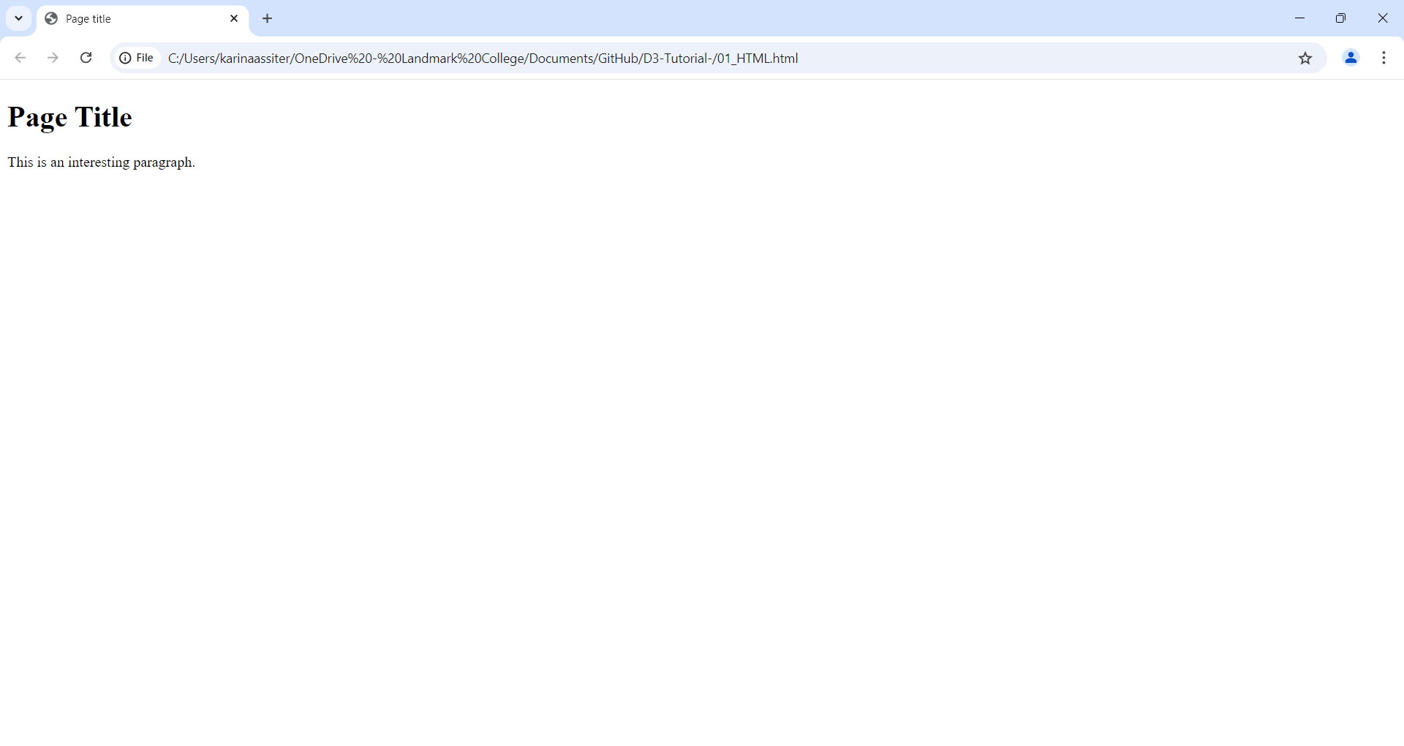
Developer Tools to view DOM

Slide 12
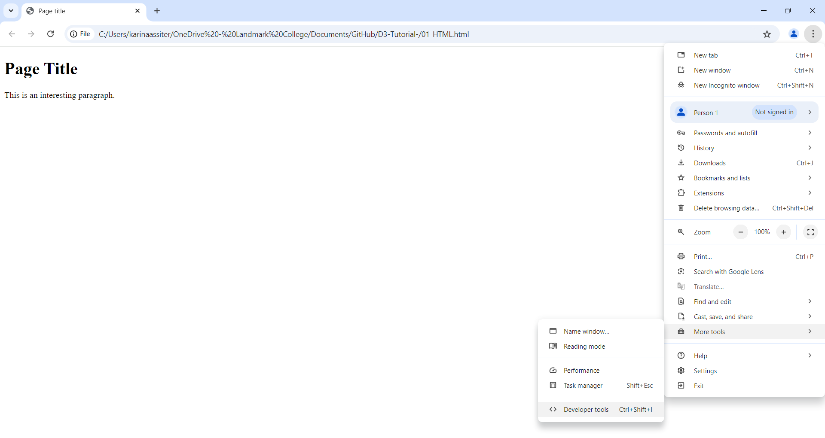
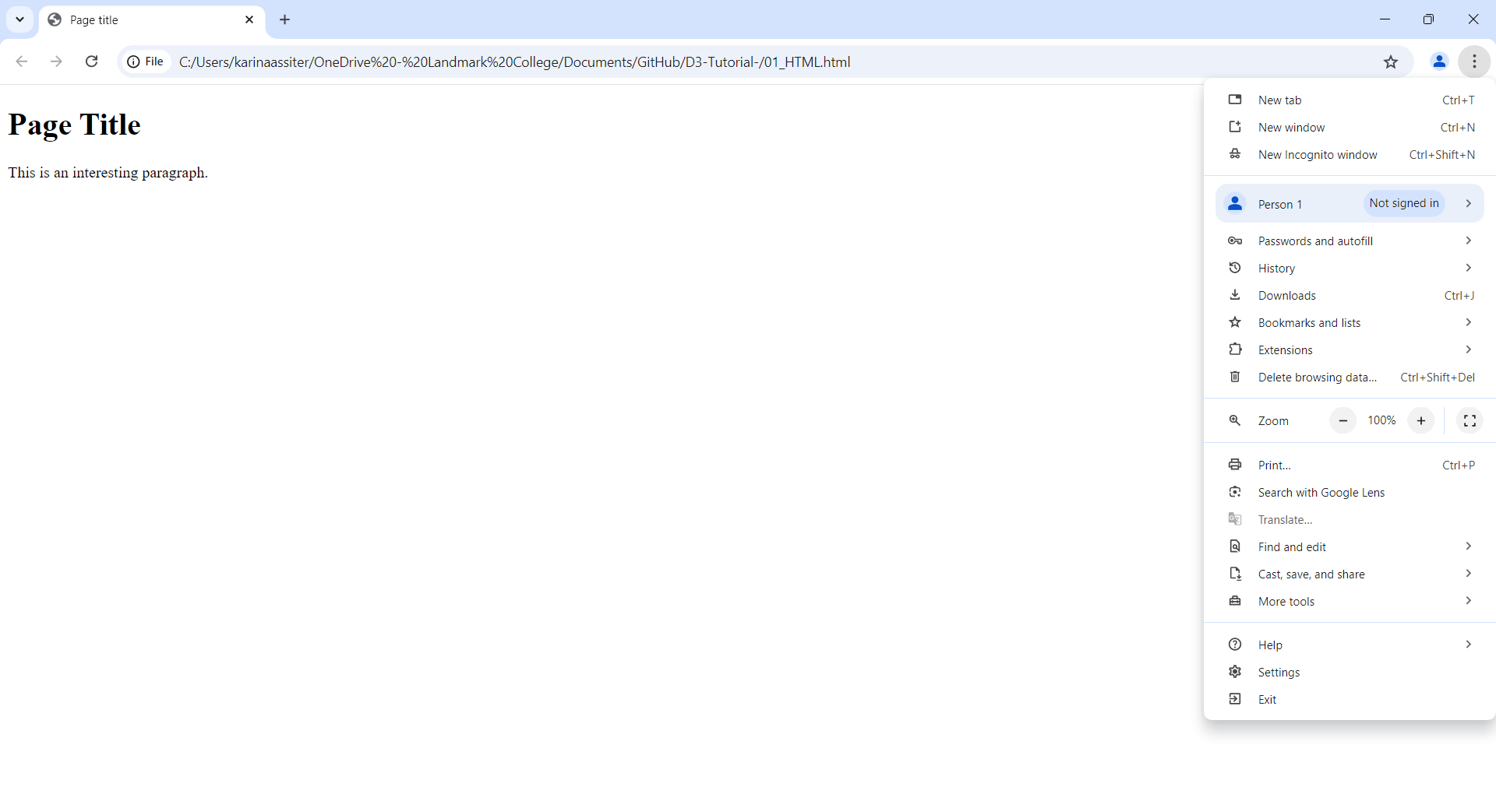
Developer Tools to view DOM

Slide 13
Developer Tools to view DOM

Slide 14
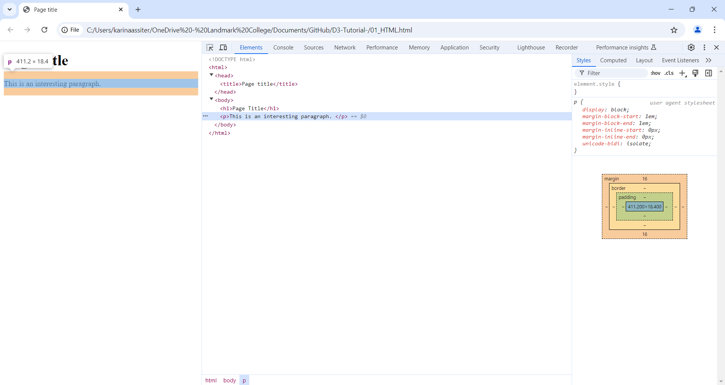
Developer Tools to view DOM

Slide 15
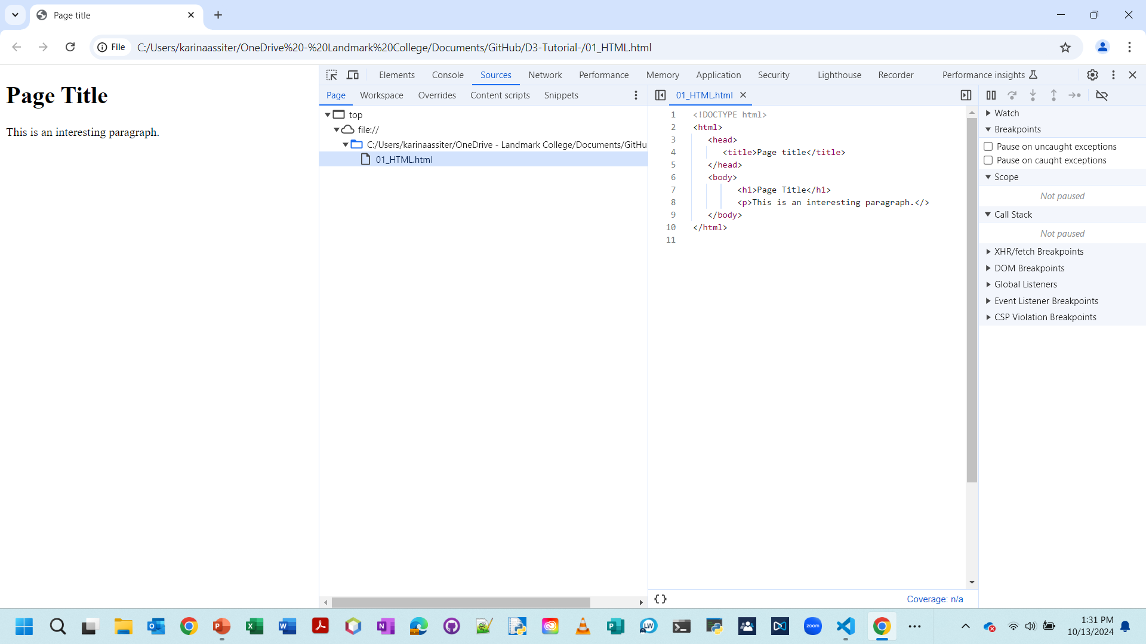
Developer Tools to view DOM

Slide 16
CSS (Cascading Style sheets)
Purpose:
Style the visual presentation of DOM elements
Consist of selectors & properties
Syntax Example
Categories of selectors
Type : h1, p, strong, em, div, etc..
Descendent: h1 em, div p
Class: .caption, .bar.highlight,
ID: #header, #nav
selector {
property: value;
property: value;
}
p,
li {
font-size: 12px;
line-height: 14px;
}

Slide 17
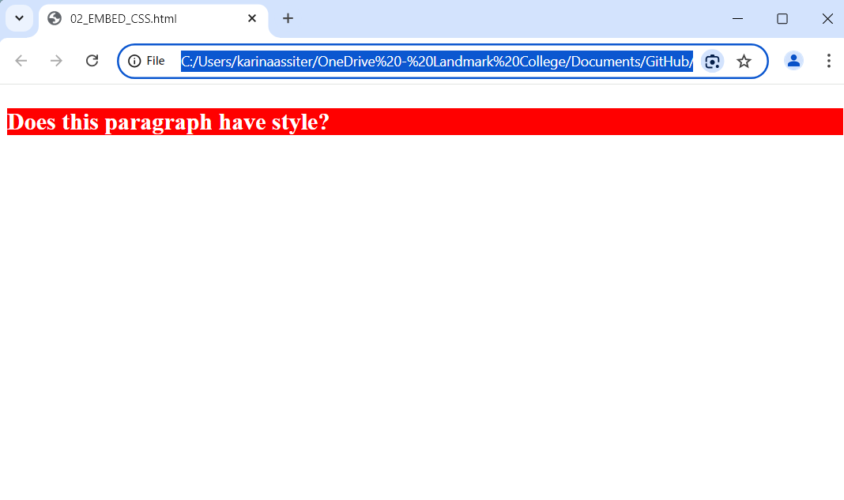
Three ways to apply CSS rules to HTML document
1. Embed CSS in your HTML head
<html>
<head>
<style type=“text/css”>
p {
font-size: 24px;
font-weight: bold;
background-color: red;
color: white;
}
</style>
</head>
<body>
<p>Does this paragraph have style?</p>
</body>

Slide 18
Three ways to apply CSS rules to HTML document
2. External style sheet
<!DOCTYPE html>
<html>
<head>
<link rel=“stylesheet” href=“style.css”>
</head>
<body>
<p>Does this paragraph have style?</p>
</body>
</html>
External file containing CSS rules.

Slide 19
Three ways to apply CSS rules to HTML document
3. Inline styles
<p style= “color: blue; font-size: 48px; font-style: italic;”>Inline styes are kind of a hassle</p>

Slide 20
Javascript
Description
Scripting language that can make pages dynamic by manipulating the DOM after a page has already loaded in the browser.
Console
Normally we write in a text file, but you can also type JavaScript code directly into your browser
Access the console
Browser
Chrome | More Tools→Developer Tools→Console
Firefox | Tools→Web Developer→Web console
Safari | Develop→Show Error Console

Slide 21
Javascript Data Types
Variables
Arrays
Objects
Objects and Arrays
You can combine these two structures create either arrays of objects or objects of arrays.
Example: Array of objects
var number = 5;
var numbers = [ 5, 10, 15, 20, 25 ];
var fruit = { kind : “grape” , color : “red” };
property
value
var fruits = [ { kind : “grape” , color : “red” } , { kind : “kiwi” , color : “brown” } ];

Slide 22
Javascript
Operators : fairly standard
Mathematical : +, -, *, /
Comparison: ==, !=, <, >, <=, >=
Logical : &&, ||
Control Structures : also standard
if()
for()
Functions
var calculateGratuity = function(bill) {
return bill * 0.2;
};
. . .
var tip = calculateGratuity(38);
console.log(tip);

Slide 23
Referencing scripts
Scripts can be included directly in HTML, between scripts tags:
Stored in a separate file with a .js suffix, and then referenced in the HTML:
<body>
<script type="text/javascript">
alert("Hello, world! ); </script>
</body>
<head>
<script type="text/javascript“ src=“myscript.js“></script>
</head>

Slide 24
Example : 03_Javascript.html
<!DOCTYPE html>
<body>
<script type="text/javascript">
// Function to display name
function greet(name) {
alert("Hello, " + name + "!");
}
// Function to calculate the sum of two numbers
function addNumbers(num1, num2) {
return num1 + num2;
}
// Example usage
greet("Karina");
let sum = addNumbers(5, 10);
console.log("Sum:", sum);
</script>
</body>

Slide 25
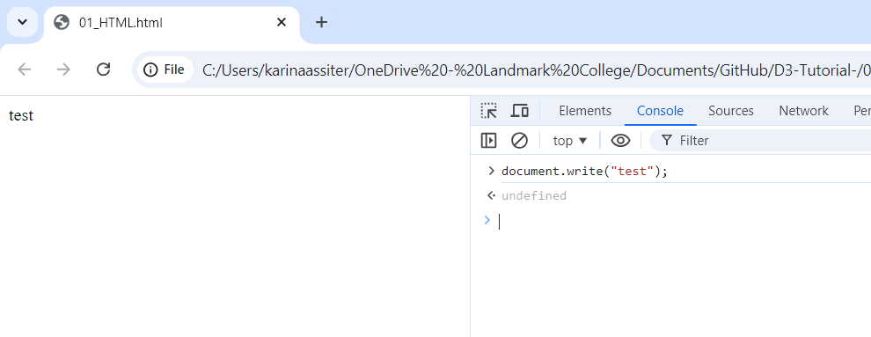
Now test out writing in the console
Type this into the console
This should appear

Slide 26
SVG (Scalable vector graphics)
D3 is most useful when used to generate and manipulate visuals as SVG’s.
Versus drawing with div’s and other native HTML elements
Every current web browser supports SVG.
SVG is a text-based image format.
Each SVG image is defined by markup code similar to HTML
SVG code can be either:
Included directly within any HTML document
Inserted dynamically into the DOM.
Before you can draw anything you must first create an SVG element (a canvas)
Example next slide…
<svg width="100" height="100">
...
</svg>

Slide 27
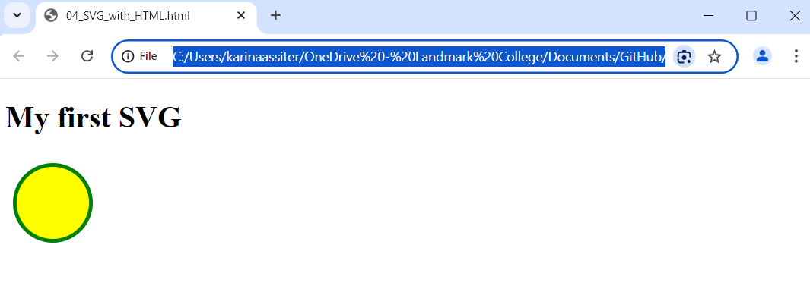
SVG EXAMPLE : 04_SVG_WITH_HTML
Example
Output
.
<!DOCTYPE html>
<html>
<body> <h1>My first SVG</h1> <svg width="100" height="100">
<circle cx="50" cy="50" r="40" stroke="green" stroke-width="4" fill="yellow" />
</svg> </body>
</html>

Slide 28
SVG coordinate system
0,0
Increasing x values
100,20
Increasing y values
200,40

Slide 29
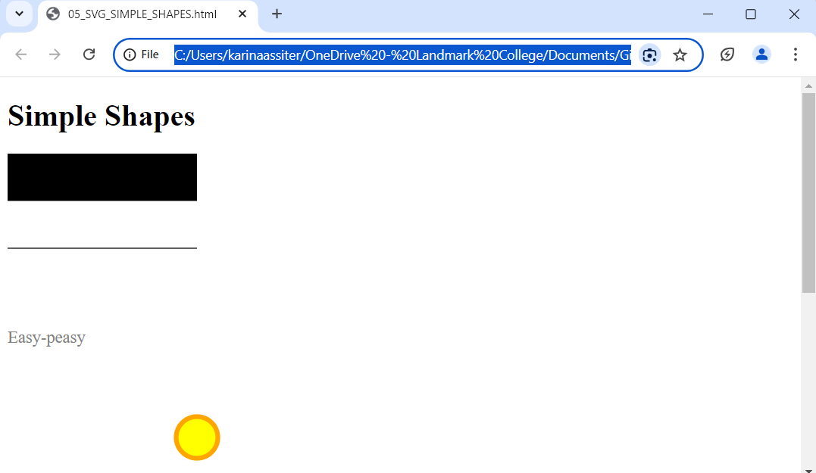
Example: 05_SVG_Simple_Shapes
<!DOCTYPE html>
<html>
<body> <h1>Simple Shapes</h1> <svg width="700" height="700">
<rect x="0" y="0" width="200" height="50"/>
<line x1="0" y1="100" x2="200" y2="100" stroke="black"/>
<text x="0" y="200" font-family="serif" font-size="18" fill="gray">Easy-peasy</text>
<circle cx="200" cy="300" r = "22" fill="yellow" stroke="orange" stroke-width="5"/> </svg> </body>
</html>

Slide 30
Setting up the Environment

Slide 31
ReQuirements for Setting up the environment
Basic knowledge of HTML, CSS, and JavaScript.
A text editor (VS Code, Sublime Text, Nodepad, etc.).
Web browser for rendering (Chrome, Firefox).
Local server for hosting (when there are data files you need to access)
We will discuss a method for setting up a local Python server
.

Slide 32
Accessing D3
In general, you can access D3 by either
Downloading the latest version from http://d3js.org
EMBEDDING the following in your HTML:
<script src="https://d3js.org/d3.v7.min.js"></script>
With the source that I provide, the latest version of d3 is included.

Slide 33
Setting up to use D3
Create a project folder
Access the files that I provide from GitHub: https://github.com/assiterk/D3-Tutorial-and place them in your project folder.
Unzip the examples
View or edit the source, use an editor of your choice such as:
VS Code
NotePad++

Slide 34
Setting up a python web server
When D3 code needs external datafiles (CSV’s or JSON files) you need to host the files on a Web server.
Setup to run a Python web server from your project folder:
.
Install Python first if you don’t already have it.
Open a terminal window (i.e., Windows Powershell)
Change to the directory (project folder) that you want served. Examples
i. If on a MAC and your project folder was on the desktop: cd ~/Desktop/project-folder
ii. Windows at given path: cd "C:\Users\karinaassiter\Documents\GitHub\D3-Tutorial-“
b. To activate server on port 8888:
Open browser and visit the following URL: http://localhost:8888/
Python version | Type
2.x | python –m SimpleHTTPServer 8888 &.
3.X or later | python –m http.server 8888 &.

Slide 35
Data

Slide 36
Visualization and data
Definition of Data Visualization
Data visualization is the graphical representation of information and data using visual elements such as charts, graphs, maps.
From https://www.tableau.com/learn/articles/data-visualization
If you can get your data into a .txt file, CSV file or a JSON document then you can use it with D3.

Slide 37
Activity : Generating page elements
Objective:
We will see how to start with a simple empty page, and generate new page elements
Instructions
Make a copy of 06_Empty_Page.html
Click the file to open it in your web browser (view as-is)
Open in an editor (VS Code, Notepad++, etc..)
Replace the comment between the script tags with:
d3.select("body").append("p").text("New paragraph!");
Save in the editor and then refresh in the browser.
Go to Developer Tools and inspect the Elements.
a. Notice that the new paragraph is now appended below the script!

Slide 38
Binding Data
Data visualization is a process of mapping data to visuals.
Data in, visual properties out (i.e., bigger numbers might mean taller bars)
Mapping rules are up to you
D3
We bind our data input values to elements in the DOM.
We use D3’s data() method to bind data to DOM elements
Data
Examples to start will be simple datasets.
Eventually we’ll see how to load CSV and JSON files.

Slide 39
Example : 08_creating_paragraphs
Objective
Understand how to use data to generate DOM elements
Instructions
Let’s view the source and run in the browser, and step through what is occurring.
In the Console, let’s type the following to see where the data actually is:
d3.selectAll(“p”)

Slide 40
Activity : Functions that accept d as input
Objective
We’ll see how we can access the data values using an anonymous functions.
Instructions
Explanation
When you chain methods together, anytime after you call data() you can create an anonymous function that accepts d as input.
Without being in an anonymous function, d is undefined.
Note:
If you had trouble, 09_creating_paragraphs_counting.html shows the solution!
Make a copy of 08_creating_paragraphs.html
Replace the .text line with:
.text(function(d) {
return "I can count up to " + d;
});
Save and refresh in the browser.

Slide 41
Example : Set HTML attributes and CSS properties on selections
Objective
Understand how to add style to you’re your paragraphs
Instructions
Open the example: 10_creating_paragraphs_with_style_functions
What does it look like is happening here:
.text(function(d) {
return "I can count up to " + d;
})
.style("color", function(d) {
if (d > 15) { //Threshold of 15
return "red";
} else {
return "black";
}
});

Slide 42
Drawing with Data

Slide 43
Example : Drawing a Bar chart with DIVS
IN HTML we could draw a bar with the following:
In D3 we will see how to generate div’s (bars) and have their heights vary based on the data.
<div style=“display:inline-block;
width: 20px;
height:75px;
background-color: teal;”>
</div>

Slide 44
Example : 11_drawing_divs.html
Objective
Understand how D3 is generating DOM elements and controlling their style
Instructions
Open 11_drawing_divs.html in your the editor (VS Code, Nodepad++,..) to view the source.
Open 11_drawing_divs.html in the browser to see its behavior.
In the developer tools inspect the Elements to see the final DOM– note that it now looks like HTML code!

Slide 45
Drawing SVG’s
First, we need to create the SVG element (canvas) in which to place our shapes
Remember that we also need to set the width and height of the SVG
We can now add shapes to the svg based on data, as in the following:
// Append svg at the end of the body, and store its returned reference for
// easy access.
var svg = d3.select(“body”).append(“svg”);
svg.attr(“width”,500).
.attr(height”,50)
var circles = svg.selectAll(“circle”)
.data(dataset)
.enter()
.append(“circle”)

Slide 46
Example : 12_drawing_SVGS_COLOR
Objective
Understand how you can create shapes on an SVG canvas and set their attributes based on data.
instructions
Open 12_drawing_svgs_color.html in your the editor (VS Code, Nodepad++,..) to view the source.
Open 12_drawing_svgs_color.html in the browser to see its behavior. Spend time comparing the source to the output.
a. Discussion: What determines the radius of the circle?
Questions?

Slide 47
Example : 13_BAR_CHART_LABELS
Objective
Understand how you can create bar charts and add labels based on data.
instructions
Open 13_bar_chart_labels.html in your the editor (VS Code, Nodepad++,..) to view the source.
Open 13_bar_chart_labels.html in the browser to see its behavior. Spend time comparing the source to the output.
Notes
(x,y) values for rects represent upper-left hand corner.
y values for the SVG canvas increase downward
a. Discussion: What’s going on with the y and height values of the rect?
Other questions? Anything you’d like me to go over?

Slide 48
Example : 14_SCATTERPLOT_LABELS
Objective
Understand how you can create scatterplots and labels based on data.
instructions
Open 14_scatterplot_labels.html in your the editor (VS Code, Nodepad++,..) to view the source.
Open 14_scatterplot_labels.html in the browser to see its behavior. Spend time comparing the source to the output.
Other questions? Anything you’d like me to go over?

Slide 49
Scales

Slide 50
Scales
Definition of scales
Functions that map from an input domain to an output domain
Benefit
Takes care of the conversions from our data values to screen coordinates.
Domains and ranges
Input domain: range of possible input data values
Output domain: range of possible output values.
Illustration
There are multiple scale types but we’ll mostly see linear scales.
Input Domain
100
500
Output Range
10
350

Slide 51
Creating a scale
Given our data set:
We can create scales for our x and y coordinates as follows:
var dataset = [ [5, 20], [480, 90], [250, 50], [100, 33], [330, 95], [410, 12], [475, 44],
[25, 67], [85, 21], [220, 88], [600, 150]];
var xScale = d3.scaleLinear()
.domain([0, d3.max(dataset, function(d) { return d[0]; })])
.range([padding, w - padding * 2]);
var yScale = d3.scaleLinear()
.domain([0, d3.max(dataset, function(d) { return d[1]; })])
.range([h - padding, padding]);

Slide 52
Creating a scale
Given our data set:
We can create scales for our x and y coordinates as follows:
var dataset = [ [5, 20], [480, 90], [250, 50], [100, 33], [330, 95], [410, 12], [475, 44],
[25, 67], [85, 21], [220, 88], [600, 150]];
var xScale = d3.scaleLinear()
.domain([0, d3.max(dataset, function(d) { return d[0]; })])
.range([padding, w - padding * 2]);
var yScale = d3.scaleLinear()
.domain([0, d3.max(dataset, function(d) { return d[1]; })])
.range([h - padding, padding]);
Were using a linear scale

Slide 53
Creating a scale
Given our data set:
We can create scales for our x and y coordinates as follows:
var dataset = [ [5, 20], [480, 90], [250, 50], [100, 33], [330, 95], [410, 12], [475, 44],
[25, 67], [85, 21], [220, 88], [600, 150]];
var xScale = d3.scaleLinear()
.domain([0, d3.max(dataset, function(d) { return d[0]; })])
.range([padding, w - padding * 2]);
var yScale = d3.scaleLinear()
.domain([0, d3.max(dataset, function(d) { return d[1]; })])
.range([h - padding, padding]);
Loops through each of the x values in our arrays and returns the largest value.

Slide 54
Creating a scale
Given our data set:
We can create scales for our x and y coordinates as follows:
var dataset = [ [5, 20], [480, 90], [250, 50], [100, 33], [330, 95], [410, 12], [475, 44],
[25, 67], [85, 21], [220, 88], [600, 150]];
var xScale = d3.scaleLinear()
.domain([0, d3.max(dataset, function(d) { return d[0]; })])
.range([padding, w - padding * 2]);
var yScale = d3.scaleLinear()
.domain([0, d3.max(dataset, function(d) { return d[1]; })])
.range([h - padding, padding]);
From small amount of padding from left edge of canvas
To right edge of the canvas, minus a small amount of padding

Slide 55
Incorporating scaled values
Now when we need the x and y values, we can use use xScale and yScale to convert to scaled coordinates:
//Create circles
svg.selectAll("circle")
.data(dataset)
.enter()
.append("circle")
.attr("cx", function(d) {
return xScale(d[0]);
})
.attr("cy", function(d) {
return yScale(d[1]);
});
Returns scaled x data value.
Returns scaled y data value.

Slide 56
List of Scales (https://d3js.org/d3-scale)
scaleLinear
Map a continuous, quantitative input domain to a continuous output range.
scaleOrdinal
Map a discrete domain to a discrete range
Example:
scaleTime
Time scales implement ticks based on calendar intervals.
Example:
scaleSqrt
Creates a square root based scale.
const color = d3.scaleOrdinal(["a", "b"], ["red", "green"]);
const x = d3.scaleTime([new Date(2000,0,1),new Date(2000,0,2)],[0,960]);

Slide 57
Example : 15_scaled_scatterplot
Objective
Understand how to use scales to convert between data and SVG coordinates.
Instructions
Open 15_scaled_scatterplot.html in your the editor (VS Code, Nodepad++,..) to view the source.
Open 15_scaled_scatterplot.html in the browser to see its behavior. Spend time comparing the source to the output.
Questions? Anything you’d like me to go over?

Slide 58
Time scales
JavaScript and D3 can only perform time and date calculations on Data objects, not on strings.
Working with dates in D3 involves:
Converting strings to Date objects
2. Using time scales as needed
3. Formatting Date objects as human-friendly strings for display to the user

Slide 59
CSV Files (time scale example will use input file)
Syntax
Values in CSV files are stored as strings
Row converter function
function you write to translate strings to numbers, dates, etc..
d3.csv( <file name> , <row converter function>)
.then(function(data) {
dataset = data;
visualizeFunction(); // uses data to build visualization
})
.catch(function(error){
console.eror(error);
})

Slide 60
Example : 16_time_scale_CSV.HTML
Objective
Understand how to work with time scales and input CSV files.
Instructions
Open time_scale_data.csv in your the editor (VS Code, Nodepad++,..) to view the contents of the CSV data file (remember, everything is read in as strings)
Open 16_time_scale.html in
An editor (VS Code, NodePad++,..) to view the source.
A browser to see its behavior. Spend time comparing the source to the output.
Questions? Anything you’d like me to go over?

Slide 61
Axes

Slide 62
Introducing Axes
As with scales, D3 axes are functions whose parameters you define
Axes functions generate visual elements of the axis, including lines, labels and ticks.
Steps:
Define the axis
Create
xAxis = d3.axisBottom()
.scale(xScale) // x axis uses x scale
.ticks(5); // set rough number of ticks
// Create a group element so we can apply transforms to all the
// components of the axis (lines, ticks, labels). Note the transform that moves the
// entire group to the bottom
svg.append("g")
.attr("class", "axis")
.attr("transform", "translate(0," + (h - padding) + ")")
.call(xAxis);

Slide 63
Example : 17_time_axis.HTML
Objective
Understand how to work with time scales and input CSV files.
Instructions
Open time_scale_data.csv in your the editor (VS Code, Nodepad++,..) to view the contents of the CSV data file (remember, everything is read in as strings)
Open 17_time_axis.html in
An editor (VS Code, NodePad++,..) to view the source.
A browser to see its behavior. Spend time comparing the source to the output.
Questions? Anything you’d like me to go over?

Slide 64
Updates, Transitions and motion

Slide 65
Introduction
So far we’ve discussed static data sets.
Real-world data changes over time
These are handled by updates
Visual adjustments are made pretty with transitions, which employ motion for perceptual benefit.

Slide 66
Simplest case : All data values updated together
Basic approach
Modify the values in your dataset (in some way)
Rebind the new values to the existing elements
Set the new attribute values as needed to update the visual display
//User clicks a paragraph, which will then update with a data
d3.select("p")
.on("click", function() {
//New values for dataset
dataset = [ 11, 12, 15, 20, 18, 17, 16, 18, 23, 25,
5, 10, 13, 19, 21, 25, 22, 18, 15, 13 ];
svg.selectAll(“rect”)
.data(dataset); // New data successfully bound
.attr("y", function(d) { return h - yScale(d); }) // New data so scales have changed
.attr("height", function(d) { return yScale(d); });

Slide 67
Example : 18_updates_All_data
Objective
Understand how to
update a visualization when the dataset values change
User the scaleBand for ordinal data (categorical data).
Add interaction with event listeners
Instructions
Open 18_updates_all_data.html in
An editor (VS Code, NodePad++,..) to view the source.
A browser to see its behavior. Spend time comparing the source to the output.
Notes
Only the y (height) attributes need to be changed for both the bars and labels
To be able to handle any new dataset you really also need to update the scales themselves.

Slide 68
Example : 19_adding_and_REMOVING
Objective
Understand how update a visualization when data is added or removed.
Instructions
Open 19_adding_and_removing.html in
An editor (VS Code, NodePad++,..) to view the source.
A browser to see its behavior.
2. This is a little more complex so we can go over this together.
3. Exercise: Add and remove labels with the updates. [do on your own time]

Slide 69
Interactivity

Slide 70
Interactivity
For the sake of time, with this topic and the others I will provide examples based on topics they illustrate and leave a detailed review of the code to you (but I welcome questions if time permits).
For interactivity, I divide the examples based on what they illustrate:
Illustrate | Example
SVG mouse over and mouse out with smooth transition | 20_mouseover_mouseout.html
SVG sorting (ascending and descending), but hover effects in CSS [Note: changing labels is left an exercise] | 21_svg_sort_htm_hover.html
Tooltips – browser : Inset title for the bar and that’s it | 22_browser_tooltip.html
Tooltips – SVG for more control : use mouse over and mouse out. | 23_svg_tooltip.html
Tooltips – HTML div elements as tooltips (hidden div) | 24_div_tooltip.html

Slide 71
Filtering Selections based on Data

Slide 72
Filtering selections based on data
Objective
Understand how you can select specific DOM elements and then use filtering based on data to change specific attributes.
Examples
Illustrate | Example | Exercises to Try
Filter paragraphs based on data (red if > 15) | 25_paragraphs.html | Change to greater then 20.
Filter bar chart based on slider threshold (red if <= threshold | 26_slider.html | Make the red dependent on the data as the blue is.
Filter circles based on radio buttons selection | 27_radio.html | Change radio buttons to 0, 200, 400, 600, 800, 1000

Slide 73
Layouts

Slide 74
Introduction to LayOUTS
D3 layouts take data that you provide and remap or otherwise transform it, generating new data that is more convenient for a specific visual task.
D3 Layouts
Chord
Cluster
Force
Pack
Partition
Pie
Stack
Tree
Treemap

Slide 75
Layouts
Objective
Understand how to use D3 Pie, Stack and Force layouts.
Layout Examples
Layout | Illustrate | Example
Pie | Simple pie chart | 28_pie.html
Stack | Stack bar anchored at bottom | 29_stacked_bar_anchored.html
 | Stacked area chart with tool tips & CSV | 30_stacked_area.html
Force | Force layout where nodes an be dragged | 31_force_draggable.html

Slide 76
Geomapping

Slide 77
Geomapping
Objective
Understand how to read in GeoJSON files, create Chloropath map, add points, provide panning, zooming, add labels.
GeoMapping Examples
Illustrate | Example
JSON files, paths, projections, Choropleth maps, adding points from CSV files with tooltips, panning, zooming with buttons. | 32_zoom_with_buttons.html
Add buttons to zoom to particular region and then reset back to full map. | 33_combo_zoom_pan.html
Add a label for states with their agricultural productivity data. | 34_labels.html

Slide 78
REferences
Official Documentation
D3.js Official Website: The official homepage, which includes links to examples, tutorials, and the full API documentation.
D3.js GitHub Repository: Source code, issues, and documentation.
Books
"Interactive Data Visualization for the Web" by Scott Murray: A fantastic beginner guide to D3.js with practical examples.
"D3.js in Action" by Elijah Meeks: A comprehensive guide to mastering D3.js with deeper dives into visualizations.
"Data-Driven Documents: D3.js" by Philipp K. Janert: Covers D3.js with a focus on data visualization techniques.

Slide 79
Topics we didn’t get to discuss
Paths
Exporting

Slide 80
References (cont.)
Tutorials
D3.js Introduction by Mike Bostock: Created by D3.js’ author, it’s an excellent starting point for learning D3.js.
FreeCodeCamp D3.js Tutorial: A great tutorial for beginners, covering basic visualizations.
D3.js Fundamentals (Data Visualization with D3.js): DataCamp’s course covering fundamental visualizations.
Online Examples
ObservableHQ D3 Examples: A gallery of examples and notebooks from Observable, the platform used by D3’s author.
Blocks by Mike Bostock: Thousands of D3.js visualization examples from Mike Bostock and others.
D3 Graph Gallery: A large collection of D3.js graph examples, categorized by chart type.

Slide 81
Teach Visualization or have an interest?
If you’re interested in sharing ideas on Visualization pedagogical approaches, please get in touch!
KarinaAssiter@landmark.edu

Slide 82
Thank You for attending!

